Slide 1
Clustering wine using Machine learning models in python
Rohitha Sai Alla,700734780
Ramyasree Kuppam-700734078
Pradeep ReddyMalgari,700741163
NamrathaRavula,700740300

Slide 2
Responsibilities and Contributions in the project
Problem description and Data Modeling: This phase includes the problem description, drafting of clear objectives and outcomes, gathering of a dataset, loading of the dataset, and also listing the required modules in python and then checking for the null values and filling them using mean values. And finding the correlation matrix is generated to finalize the features of modeling. This task is accomplished by Ramyasree Kuppam-700734078.
Clustering Analysis: This phase includes the analysis of the problem by using different types of clusters and finding the more appropriate solution.
K-Means Clustering: In this phase, we use the k-means cluster with a different number of clusters to find the optimal cluster which separates the data in a more efficient way. This task is accomplished by Rohitha Sai Alla-700734780

Slide 3
Affinity Propagation Clustering: In this phase, we build the affinity propagation model to find whether this clustering is suitable for our problem or not and compare the clustering with the previous k-means clustering. This task is accomplished by NamrathaRavula,700740300.
Birch Clustering and DB Scan Clustering: In this phase, we are evaluating two kinds of clustering models and comparing this with our previous clustering models, and finding the more appropriate models for our problem. This task is accomplished by Pradeep Reddy Malgari,700741163.
Contributions :
Rohitha Sai Alla,700734780 25%
Ramyasree Kuppam,700734078 25%
Pradeep Reddy Malgari,700741163 25%
NamrathaRavula,700740300 25%

Slide 4
Motivation and Objectives
Leading wine distributor Champagne Company specializes in bringing premium and super-premium wines, champagnes, and spirits into the East African region. The company's major objective is to increase accessibility to the most expensive wine labels at a reasonable price. The business aims to meet the rising local need for specialized goods and the expanding tourism market, where visitors will not accept less.
Analyse the data in terms of various features responsible for Wine Clustering
Finding the most suited machine learning model for the correct classification of clustering.

Slide 5
Feature analysis using the correlation matrix
Here we used the python module SK learn to calculate the correlation between the columns and also other calculations such as the Variance inflation factor to select the most influencing features for the wine prediction.

Slide 6
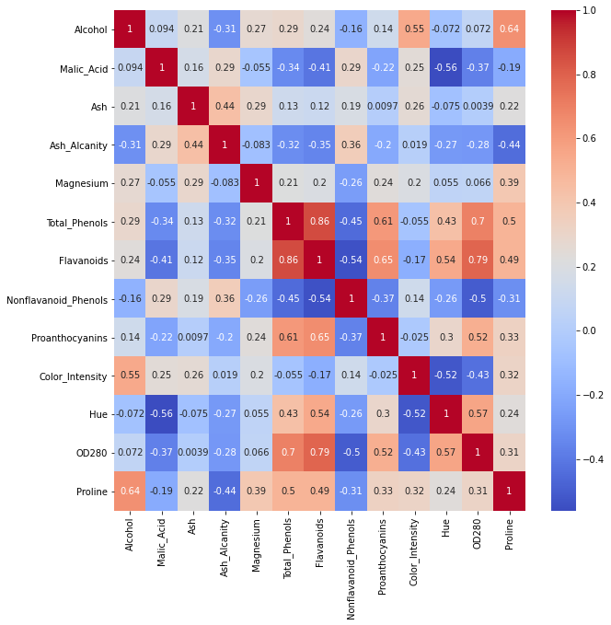

Slide 7
Problem statement
The task of a Data Scientist working is to perform wine segmentation using the given dataset. The dataset contains the findings of a chemical examination of three different varieties of wine produced in the same area of the United States.
Upon modeling, we are required to perform statistical analysis on the clusters, highlighting key findings, and making recommendations on business decisions based on your findings. Also, we want to build a classification machine learning model to carry out the predictions. This will include data processing to make the dataset variables ready for machine learning algorithms during the designing of the data models to improve the accuracy of the model predictions. The project will be implemented in the Jupyter Notebook environment to generate the final notebook file.

Slide 8
Proposed Solution
The K-means clustering method, together with an optimum K search and filtering mechanism, was suggested and implemented. In the result section, you will find detailed clustering results that were constructed using different clustering methods which are Affinity Propagation, Birch Clustering, and DB Scan Clustering.
K-means algorithm generally works on the centroid of clusters i.e based on the number of clusters, for each clusters we have to find the middle point of data which equally seperates the data .
We have to repeat this for every cluster and find the best optimal solution.

Slide 9
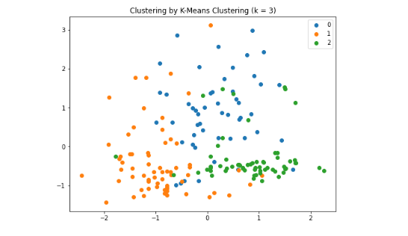
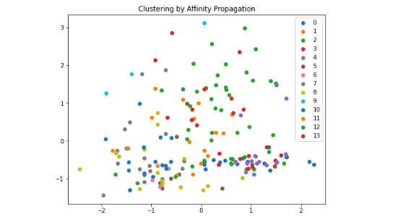
Results

Slide 10
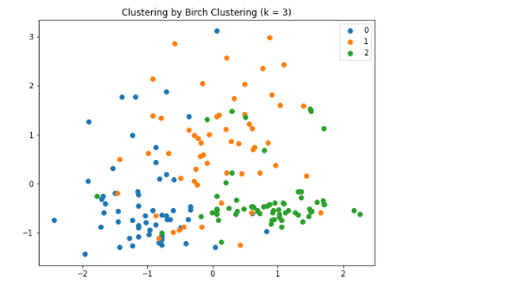
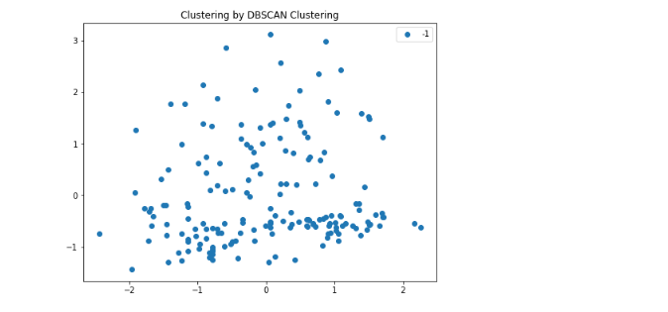

Slide 11
References
Trivedi, A., & Sehrawat, R. (2018, July). Wine quality detection through machine learning algorithms. In 2018 International Conference on Recent Innovations in Electrical, Electronics & Communication Engineering (ICRIEECE) (pp. 1756-1760). IEEE.
Luna, R., Araya, M., Caris, J., & Cuevas-Valenzuela, J. (2020, November). A Digital Platform for the Management of Grapes and Wine Quality in the Winery. In 2020 39th International Conference of the Chilean Computer Science Society (SCCC) (pp. 1-7). IEEE.
Aich, S., Al-Absi, A. A., Hui, K. L., Lee, J. T., & Sain, M. (2018, February). A classification approach with different feature sets to predict the quality of different types of wine using machine learning techniques. In 2018 20th International conference on advanced communication technology (ICACT) (pp. 139-143). IEEE..

